Slide 1
RUNGTA COLLEGE OF DENTAL SCIENCES & RESEARCH
TITLE OF THE TOPIC:IRRIGANTS AND IRRIGATION
DEPARTMENT OF CONSERVATIVE DENTISTRY AND ENDODONTICS

Slide 2
Specific learning Objectives
At the end of this presentation the learner is expected to know ;
Core areas* | Domain ** | Category #
ANATOMY OF PERIAPEX CEMENTUM PERIODOTAL LIGAMENT INGLES CLASSIFICATION ZONES OF FISH | COGNITIVE | MUST KNOW
PATHWAY OF ENTRY OF MICROORGANISMS IN TOOTH | PSYCHOMOTOR | NICE TO KNOW
DIAGNOSIS OF PERIAPICAL TISSUE ENDO PERIO LESSIONS | AFFECTIVE | DESIRE TO KNOW

Slide 3
Contents
Introduction
Ideal properties of irrigating solutions
Goals of irrigation
Classification of irrigating solutions
Individual irrigants
Sodium hypochlorite(naocl)
Hydrogen peroxide (3% h₂o₂)
Iodine compounds
Chlorhexidine gluconate
Organic acids
-Edta
-Citric acid

Slide 4
Ruddle’s solution
Urea
Physiologic saline solution
Mtad
ozone
Combination of irrigants
Selection of irrigants
Methods of irrigation
Various delivery systems for irrigation
Complications during irrigation

Slide 5
Selection of irrigants
New modalities of irrigation
Summary
Conclusion
References

Slide 6
IODINE COMPOUNDS
Traditional root canal disinfectant (1979)
2% iodine in 4% potassium iodide

Slide 7
can penetrate into microorganisms & attacks cell molecules such as proteins, nucleotides & fatty acids, resulting in cell death.
kills a wide spectrum of microorganisms found in root canals.
Iodine compounds are bactericidal, fungicidal & virucidal.

Slide 8
Properties
Aqueous iodine solutions are rather unstable; in solution, several iodine species are present with molecular iodine being mostly responsible for the antimicrobial activity.
This was the reason for the development of Iodophors (iodine carriers): povidone iodine and poloxamer iodine.
Iodophors are complexes of iodine and a solubilising agent or carrier, which acts as a reservoir of the active ‘free’ iodine.

Slide 9
Mechanism of action
sulfhydryl groups of bacterial enzymes
cleaving disulfide bonds
Combinations of IKI and CHX may be able to kill calcium hydroxide-resistant bacteria more efficiently
Notes:
Iodine acts as an oxidizing agent by reacting with

Slide 10
Although germicidal activity is maintained, iodophors are considered less -active against certain fungi and spores than are tinctures (alcoholic solutions of iodine).
In endodontics, Iodine potassium iodide (IKI) has been the final component of the classical tooth surface disinfection sequence, as described by Moller.
Marketed as-Betadine

Slide 11
Effect on microbial flora
The effectiveness of 2.5 % NaOCl and 10 % iodine has been compared by bacterial culturing and polymerase chain reaction
No significant difference in the recovery of cultivable bacteria from various sites in either group was detected
However bacterial DNA was detected significantly more frequently from tooth surfaces after iodine treatment than after NaOCl treatment

Slide 12
Molander et al suggested that irrigation with 5 % IPI before Ca(OH)2 medication did not have an effect on the overall antimicrobial power
However, it is possible that IPI reduces the frequency of persisting strains of E. faecalis
Peciuliene et al showed that when used after normal chemo mechanical preparation, IPI increased the number of culture negative canals.
Notes:
IEJ 2001

Slide 13
Portenier et al showed the inhibitory effect on 0.2/0.4% IPI by dentine, (organic) dentine matrix, and heat-killed cells of E. faecalis and C. albicans.
These studies indicate that inactivation of iodine compounds is one factor explaining the difficulty in obtaining sterile root canals

Slide 14
Disadvantages
Iodine causes an allergic reaction in some patients
Substances commonly found in the root canal inhibit the antimicrobial efficiency of iodine
Iodine has also the potential to stain dentine

Slide 15
30% H₂O₂ (Superoxol) – tooth surface disinfection.
It acts on the organic matter on the tooth making other disinfectants like iodine , more effective.
It has been widely used earlier for cleaning the pulp chamber from blood and tissue remnants

Slide 16
Chelating agent
The term 'chelate' originates from the Greek word 'chele' (crab claw).
Chelates are particularly stable complexes of metal ions with organic substances as a result of ring-shaped bonds.
This stability is a result of the bond between the chelator, which has more than one pair of free electrons, and the central metal ion.
Grossman et al. 1988, Zeeck et al. 1992

Slide 17
The ability of chelators to bind and inactivate metallic ions is widely exploited in medicine.
Chelators can be used to bring about excre­tion of dangerous ions in the case of metal poisoning or in the treatment of copper metabolism disturbances.
Zeeck etal.1999

Slide 18
Ethylene diamine tetra acetic acid (EDTA)
In 1951, the first reports on the demineralizing effect of ethylene diamine tetra acetic acid (EDTA) on dental hard tissues were published.
Hahn & Reygadas , Screebny & Nikiforuk 1951

Slide 19
Ethylene diamine tetra acetic acid (EDTA)
Chelators were first introduced to endodontics by Nygaard-0stby (1957), who recom­mended the use of a 15% EDTA solution (pH 7.3) with the following composition.
Disodium salt of EDTA (17.00 g)
Aqua dest. (100.00 mL)
5 M sodium hydroxide (9.25 mL)

Slide 20
A few years later, a detergent was added in order to increase the cleaning and bactericidal potential of the EDTA solution, the new composition being known as EDTAC.
EDTA in its pure form already has a lower surface tension than 1 or 5% sodium hypochlorite (NaOCl), saline solution or distilled water.
Von der Fehr & Nygaard-0stby 1963
Tasman et al. 2000
Notes:
This addition is aimed at reducing the surface tension of the irrigant, facilitating the wet­ting of the entire root canal wall and thereby increasing the ability of the chelators to penetrate the dentine.

Slide 21
Initially, chelators were used as liquids for irrigation during mechanical instrumentation of the root canal system.
In 1969, Stewart et al. presented RC-Prep (pre­mier Dental; Philadelphia, PA, USA), probably the best known paste-type chelating agent.

Slide 22
Although the efficacy of liquid and paste-type EDTA preparations in softening root dentine has been a point of controversy, chelator pre­parations have been advocated frequently as adjuncts for root canal preparation, especially in narrow and calcified root canals and for removal of the smear layer.
Serene 1976, Stock & Nehammer Stewart 1986, 1995, Weine 1988, Lovdahl & Gutmann 1997), (McComb & Smith 1975, Goldman et al. 1985, Berg et al

Slide 23
Recently, paste-type chelators have gained popularity as almost all manufacturers of nickel-titanium instruments recommend their use as a lubricant during rotary root canal preparation, presumably to reduce the risk of instrument separation.
Scelza et al. 2000

Slide 24
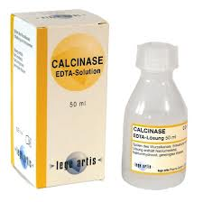
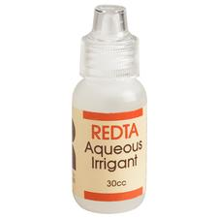
Liquid chelators
Calcinase (lege artis, Dettenhausen, Germany) is a liqiud chelator preparation and contains 17% sodium edetate, sodium hydroxide as a stabilizor and purified water.
REDTA (Roth International, Chicago, IL., USA) is a17% EDTA solution with the addition of 0.84 g Cetyl-tri- methyl ammonium bromide (Cetrimide) to reduce sur­face tension. The other ingredients are 9.25 mL 5 M sodium hydroxide and 100 mL distilled water.

Slide 25
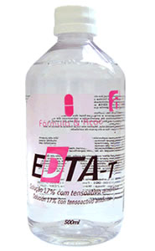
EDTAC and DTPAC are solutions of EDTA (15%) and diethyl-triamine-penta acetic acid (DTPA) at pH 8. When 0.75 g of the detergent Cetyl-tri-methyl ammonium bromide is added to 100 mL of these solutions, respec­tively.
EDTA-T (Formula & Agao Farmacia, Sao Paulo, Brazil) consists of 17% EDTA plus sodium lauryl ether sulfate (Tergentol) as a detergent (Scelza et al. 2000).
Salvizol (Ravens, Konstanz, Germany) is based on a 5 % amino-quinaldinum diacetate in propylene glycol and has a pH of 6.6 (Kaufman et al. 1978).

Slide 26
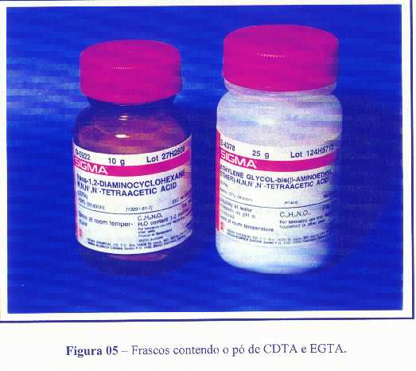
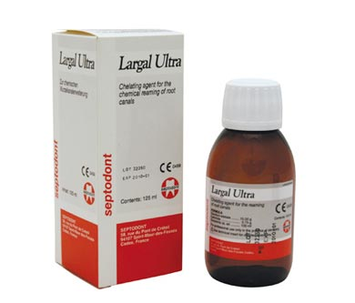
EGTA (Sigma, St Louis, MO, USA) is a chelator whose main component is ethylene glycol bis (p-amino-ethyl ether)-N,N,N',N'-tetra acetic acid. It is reported to bind Ca⁺ more specifically than EDTA (Calt & Serper 2000).
CDTA (experimental solution) is a 1% solution of cyclohexane-1,2-diaminetetraacetic acid (Cruz-Filho et al. 2001).
Largal Ultra (Septodont, Paris, France) contains a 15% EDTA solution as a disodium salt, 0.75% Cetyl-tri-methyl ammonium bromide (Cetrimide) and sodium hydroxide to adjust the pH value to 7.4

Slide 27
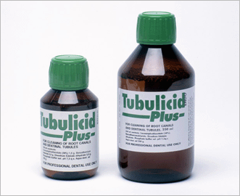
Tubulicid Plus (Dental Therapeutics, Nacka, Sweden) contains 1.5 g Amphoteric-2 (38%),0.5 benzalkonichloride, 3 g disodium EDTA dihydrate, phosphate buffer solu­tion pH 7.3 q.s., 100 g distilled water and 50% citric acid.

Slide 28
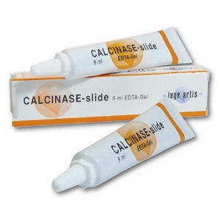
Paste chelators
Calcinase slide (lege artis, Dettenhausen, Germany) contains 15% sodium EDTA and 58-64% water, but no peroxides, colourants or preservatives (self-preserving).

Slide 29
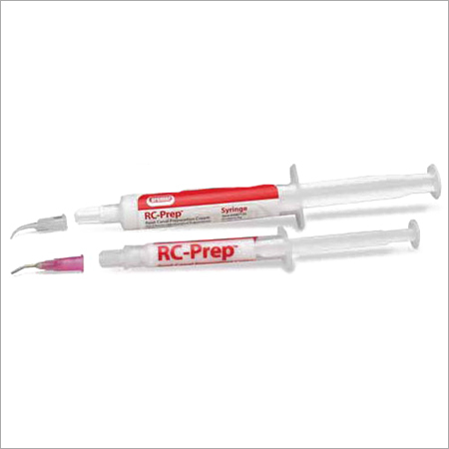
RC-Prep (Premier Dental, Philadelphia, PA, USA) is a combination of 10% urea peroxide, 15% EDTA and glycol in an aqueous ointment base. Oxygen is set free by the reaction of RC-Prep with a NaOCl irrigant so that pulpal remnants and blood coagulates can be easily removed from the root canal wall (Stewart et al. 1969).

Slide 30
Glyde file (DeTrey Dentsply, Konstanz, Germany) is composed of15% EDTA and 10% ureaperoxide in aqueous solution, and its viscosity is dependent on storage condi­tions.
Notes:
. It was developed for use with NaOCl irrigants, because the oxygen release from urea peroxide caused effervescence and this is claimed to facilitate the removal of dentine particles and pulpal remnants. In addition to this, internal bleaching is claimed to take place

Slide 31
Hypaque (experimental solution) is composed of 5% NaOCl, 17% EDTA and hypaque, a high-contrast inject- able dye for angiography and arteriography (Scarfe et al. 1995).
Hypaque is an aqueous solution of two iodine salts, diatrizoate meglumine and sodium iodine.

Slide 32
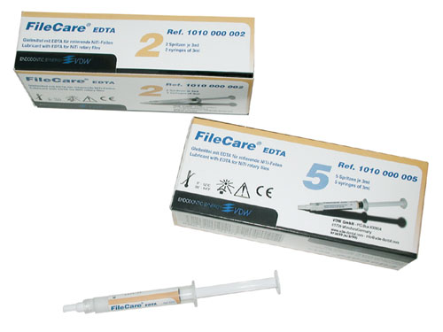
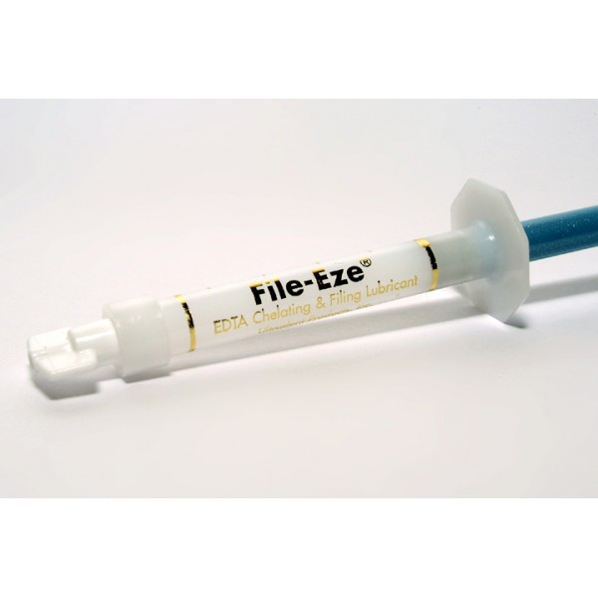
FileCare EDTA (VDWAntaeos, Munich, Germany) also is composed of 15% EDTA and 10% urea peroxide.
File-EZE (Ultradent Products, South Jordan, UT, USA) is a chelating agent in an aqueous water-soluble solution containing 19% EDTA.

Slide 33
Mechanism of action
They function by forming calcium chelate solution with calcium ions of dentine. The dentine thereby becomes more friable and easier to instrument.
Their action is to substitute sodium ions which combine with the dentine to give soluble salts, for calcium ions that are bound in less soluble combination. The walls of canal are thus softer and canal enlargement is facilitated.

Slide 34
Results have shown that a neutral EDTA solution reduces the mineral and non-collagenous protein (NCP) component of dentin, leading to surface softening but not to erosion of the surface dentin layer.
EDTA can not only remove calcium ions but also water soluble NCP and phoshoproteins at a neutral pH.

Slide 35
EDTA solution seems to be limited in its ability to demineralise because each relatively large chelator molecule can only bind a single calcium ion. When all molecules are bound, the reaction stops.
The effect of chelators depends on the width of the root canal and that only an insufficient amount of active substances can be introduced into the narrow canals.
REVIEW:Chelating agents in root canal treatment: mode of action and indications for their use.International Endodontic Journal, 36, 810-830, 2003.

Slide 36
Effect on microbial flora
EDTA has limited antibacterial effects.
On direct exposure for extended time EDTA extracts bacterial surface proteins by combining with metal ions from the cell envelope, which can eventually lead to bacterial death.
This is thought to be because of chelation of cations from the outer membranes of bacteria.
Antibacterial properties of EDTA depend on concentration and pH.

Slide 37
By combining NaOCl with EDTA, bactericidal effect was enhanced because of smear layer removal by EDTA . Against most anaerobic bacteria, 0.5% and 5% NaOCl are equally effective.
Bystrom and Sundquist 1992

Slide 38
TAKE HOME MESSEGE
Some of the problems that dentists face in their clinical practice are caused or facilitated by improper treatment of the root canal system.
In an attempt to accomplish the major goals of root canal treatment, namely to prevent and/or to control endodontic infections, clinicians use procedures, substances and materials that may induce some degree of injury to the periradicular tissues.
Invariably, periradicular tissue healing will occur uneventfully in cases where microorganisms were successfully eliminated from and/or prevented from gaining entry into the root canal system and minimal or no damage was inflicted on the periradicular tissues during therapy.
The worst-case scenario for periradicular tissue response to intra-canal procedures is reflected largely in post-operative pain and persistence of periradicular disease despite treatment. While the development of post-operative pain is largely a short-term response related to the extent of tissue injury, post-treatment disease is a long-term response influenced by the persistence of the source of injury.
Even though chemical and mechanical factors can be involved with unfavorable responses of the periradicular tissues to intracanal procedures, microorganisms are the major causative agents of post-operative pain and posttreatment disease.

Slide 39
Questions 1. Write a short note on chelators. 2. EDTA as irrigant. 3. Explain mechanism of action of iodine as irrigant.

Slide 40
References
Operative Dentistry – MA Marzouk
Art & science of operative Dentistry – Sturdevants (5th edition)
Art & Science of Operative Dentistry – Sturdevants (South Asian Edition)
Textbook Of Operative Dentistry – Vimal K Sikri (1st Edition)
Dental Anatomy, Physiology & Occlusion – Wheeler’s (9th Edition)
Optimizing tooth form with direct posterior composite restorations JCD Oct-Dec 2011 | Vol 14 | Issue 4

Slide 41
THANK YOU

